Slide 1
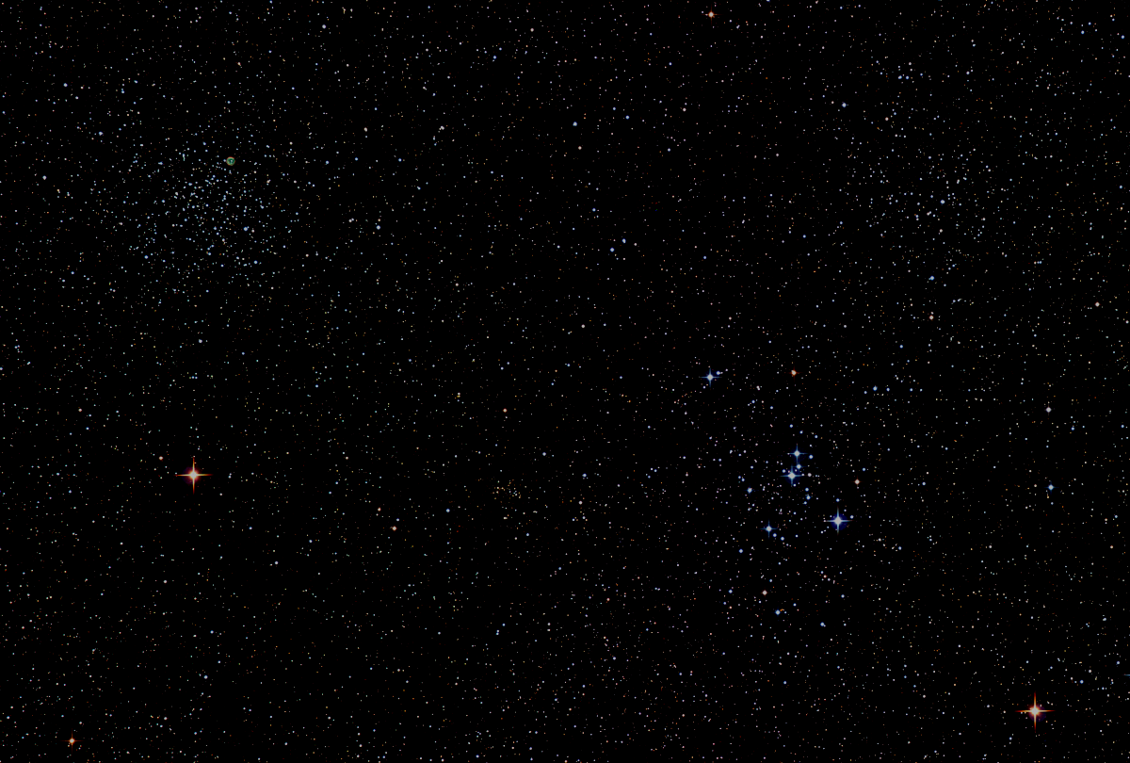

Howard
Astronomical
League
17
February 16th, 2017

Slide 2
Introductions

Slide 3
Treasury Report
Bob Savoy

Slide 4
HAL 2016 Financial Summary
      2016 Starting Bank Balance: $5,358
      2016 Income
        Memberships: $4,485
        Donations: $1,000
        Other: $ 119
      2016 Cash added to Bank: $5,604
      2016 Expenses
        Recurring: $2,235 (note 1)
        Non-recurring: $1,098 (Note 2)
      2016 Cash spent from Bank: $3,333
      2016 Ending Bank Balance: $7,629
      Note 1: AL, Insurance, Website, Mailbox, IDA, CSC
      Note 2: Materials and supplies needed to keep
      HALO operating and in good condition
HAL Membership Stats
12/31/14: 178 12/31/15: 234 12/31/16: 219

Slide 5
HAL Librarian Needed
Not overly demanding
Great first time position on the Board
Great way to become involved with the observatory
Speak to any HAL officer, or send an email to leaders@howardastro.org

Slide 6
Upcoming Events
February 20-26 - Winter Star Party, Florida Keys.
March 4th - Public star party, Alpha Ridge Park.
March 22-26 - Chaos Spring Star Party, Scottsburg, VA.
March 25th - Members Only star party, Alpha Ridge Park.

Slide 7
Night Sky Summary
Sun sets at 5:46 on Feb 16. Daylight savings begins Mar 12. Sets at 7:16pm on Mar 16.
Moon: |◐ Feb 18|⚪ Feb 26|◑ Mar 5|⚫ Mar 12|
Best earthshine view is around Mar 1.
Planets: Venus reaches peak brightness on Feb 17-18 in the western sky, and begins to fall off in early March. It appears as a waning crescent, rapidly increasing in apparent size. Find Mars near Venus, decreasing in apparent size. Jupiter is a morning object, rising around midnight and still approaching opposition. Saturn is a morning object rising shortly after dawn.
Constellations: Orion, Taurus, Pleiades are well up by sunset.

Slide 8
Observing Challenge
Bi-daily Observations of Venus
Venus reaches inferior conjunction on March 25th as it ends its present evening apparition, and passes into the morning sky. On this particular conjunction, Venus will be near its maximum ecliptic latitude, meaning that it will be about 8-degrees north of the sun. In this configuration, bi-daily, or morning and evening of the same day, observations of Venus are possible within a few days of the conjunction.
Look for reminders that this opportunity is coming, get out and observe, and look for a call for observations just prior to the April meeting.

Slide 9
HAL Social Media
Website:
http://www.howardastro.org
Facebook:
https://www.facebook.com/groups/howardastro/
Yahoo Group (mailing list):
https://tech.groups.yahoo.com/group/howardastro/
Notes:
Mention the HAL Yahoo group has over 400 members, and the Facebook group has 282 members. Obviously, not all of those folks are HAL members, but they are all astronomy enthusiasts

Slide 10
Guest Speaker
Dr. Ira Thorpe
The 100-year History of Gravitational Waves, and the LISA/LISA Pathfinder Missions
Notes:
Dr. James Ira Thorpe is a researcher in the Gravitational Astrophysics Laboratory at NASA’s Goddard Space Flight Center whose research focuses on the technologies, mission design, and astrophysical science case for space-based gravitational wave observatories. Born in Santa Fe, NM, Ira attended Bucknell University in Lewsiburg, PA and graduated summa cum laude with degrees in Mechanical Engineering and Physics in 2001. Ira received his Ph.D. in Physics from the University of Florida in 2006, with thesis work on the laser metrology system for the LISA concept. Ira joined NASA/GSFC as a postdoctoral fellow in 2007 and converted to a civil servant in 2009. Ira is the NASA representative on the LISA Pathfinder Science Working Team and the study scientist for NASA’s L3ST, which is currently evaluating options for US participation in an ESA-led gravitational wave observatory.

Slide 11
Member’s astrophotos
and sketches

Slide 12
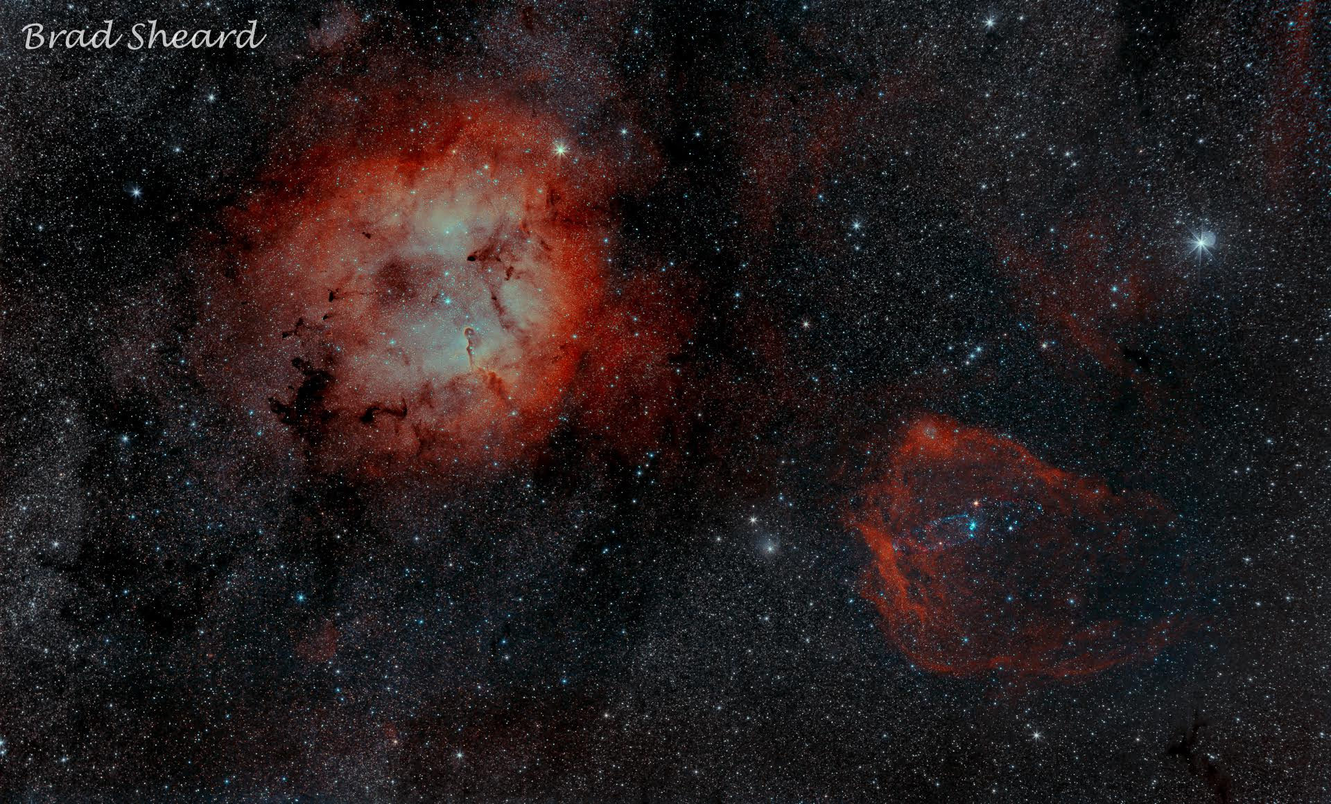

Slide 13
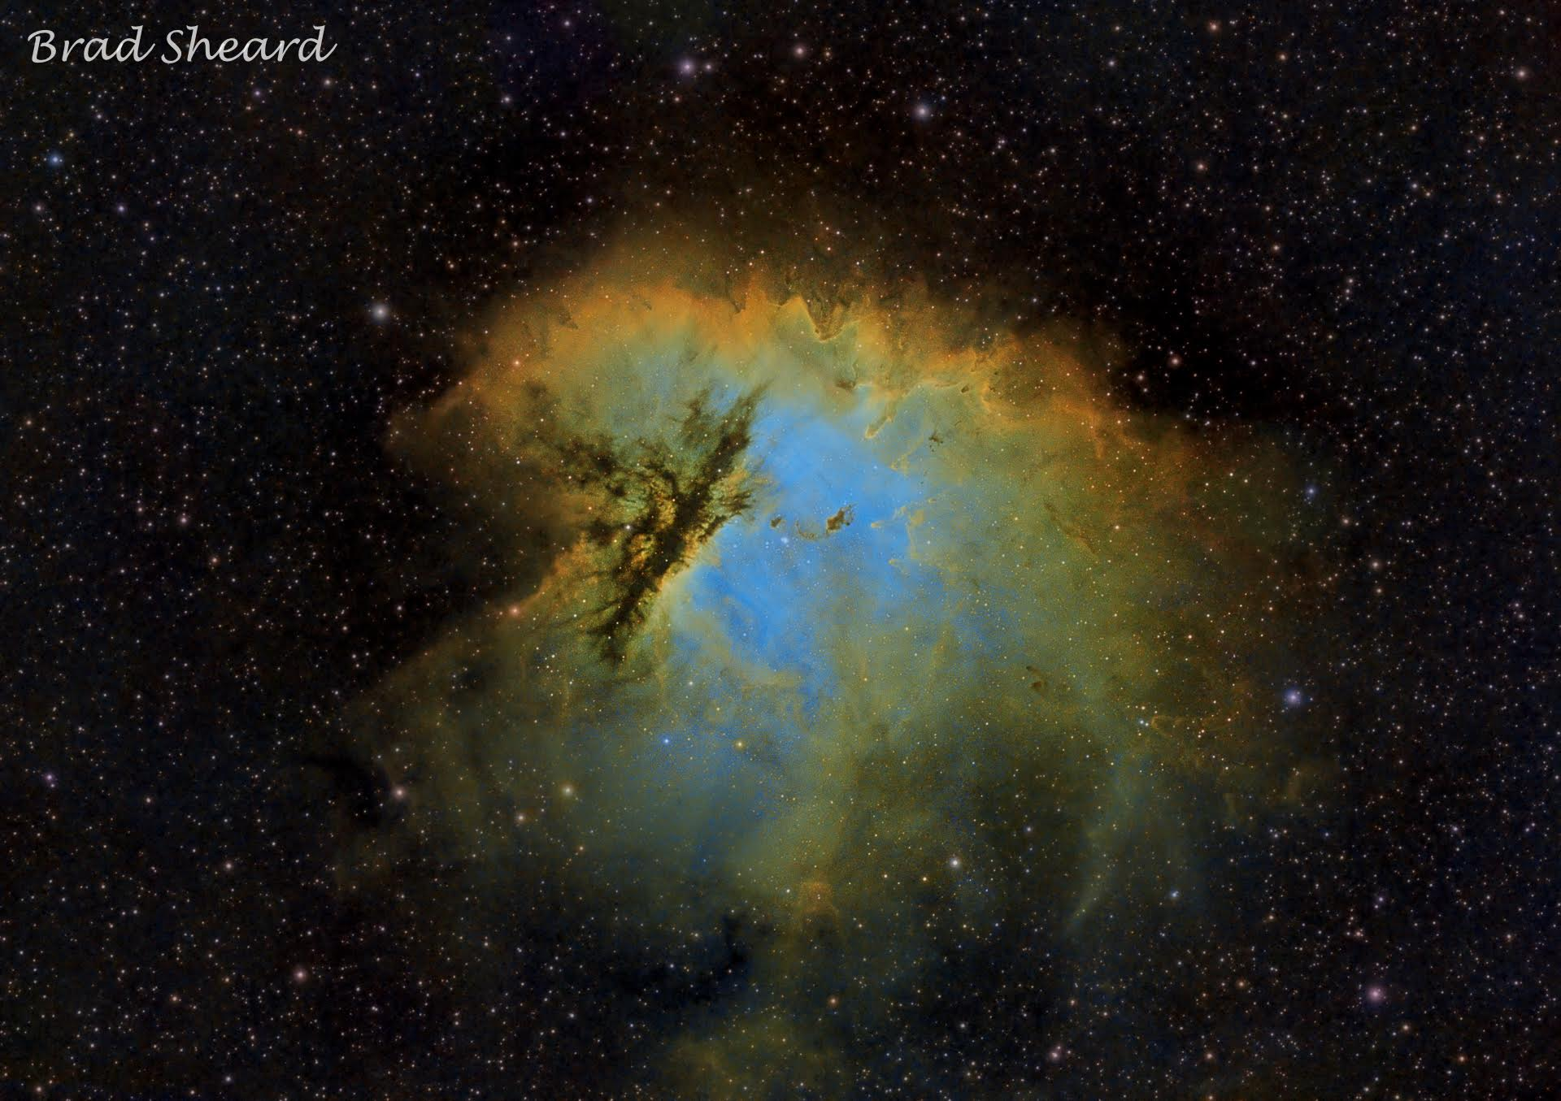
+

Slide 14
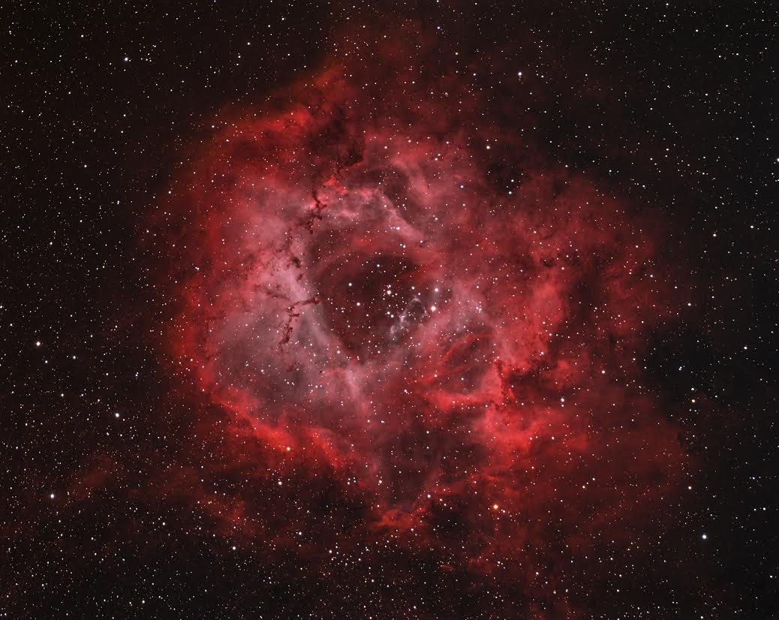

Slide 15
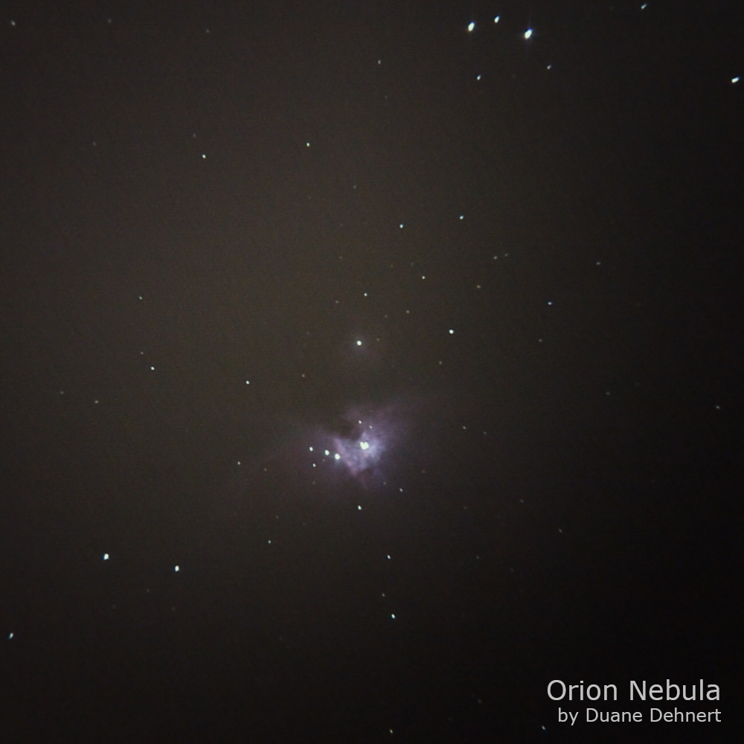
Notes:
Orion Nebula
Orion 130ST. 10 Lights, 10 seconds at ISO 400. 3 Darks, Processing - Deep Sky Stacker. Location, Downtown Baltimore. Taken at a 17mm eyepiece with Galaxy S6.

Slide 16
HAL Star Party Etiquette
Special Topic

Slide 17
Before you leave home...
Pack everything that you need
  Batteries, cables, eyepieces, tools, camera(s), red light
Dress for the weather
  More layers of clothing than you think you’ll need.
Bring snacks/drinks
Have an observation/photography plan

Slide 18
Consider the type of star party...
Public
  Scopes set up by members to share views with the public and other members
Members Only
  A member benefit
  Members usually pursue personal observing/astrophotography programs
  Scopes may or may not be available for sharing views
Impromptu
  When that rare clear sky pops up!
  Members only
  Look for keyholder announcement (members, if opted in)

Slide 19
Once you arrive...
Select a space that works for you
  Alpha Ridge vs. Carrs Mill
  What do you want to observe?
  Near the entrance if leaving early
  With people or on a quiet edge
Turn off/cover trunk and door lights
Take advantage of the remaining daylight to set up
Take some time to get to know the people around you

Slide 20
Once it gets dark...
Enjoy that rare clear sky that you have waited so long for
Enjoy the company of like-minded amateur astronomers
  Conversation is always welcome, but loud noise can be distracting
Protect your neighbors’ night vision with red lights/screen covers
Refrain from running automobile engines until you are leaving

Slide 21
When it is time to leave...
Parties generally end at 11pm
  Host’s discretion, will announce
Maintain red light discipline of others are still observing, except…
Turn on headlights when driving out
  Required for safety reasons
  Let observers around you know so that they can cover up as needed
Do not leave cars in the park!

Slide 22
Most importantly...
Show up!
Jim-ism: 85% of life is showing up
Enjoy your evening
Star parties can be a heckuva lot of fun
Enjoy sharing astronomy with others
Rewarding - you’re hooked the first time that you amaze a youngster!

Slide 23
Astronomy Humor
You Matter.
Unless you multiply yourself by the speed of light squared. Then, of course...
You Energy.
E=MC²
Notes:
A collection of summer time showcase objects that are easy to star-hop to.

Slide 24
Thank You!
Next month’s meeting is on Thursday, March 16th, 2017 7 PM
Guest Speaker:
Elizabeth Warren
Director, UMD Observatory

